Slide 1

206: Engaging Families Experiencing Opioid Use, Addiction, and Recovery

Slide 2
Section I: welcome and introductions

Slide 3
Name Tent
Personal goal for this training
County
NAME
Experience with families experiencing opioid use or addiction?
Years of service

Slide 4
Learning Objectives:
Identify the impact of opioid use, addiction, and recovery on child development
Identify warning signs of opioid use and abuse
Discuss the five components of recovery
Engage parents in conversations regarding opioid use, addiction, and recovery

Slide 5
Section II: Culture of addiction

Slide 6
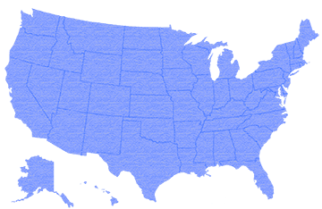
Our Culture of Addiction
Addiction is present in all cultures, but it is possible that the American experience is one that makes us more prone to the risk factors associated with addiction.

Slide 7
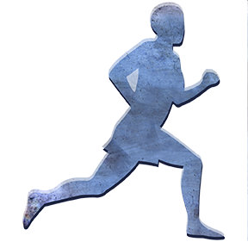
Our Culture of Addiction (continued)
Factors that may influence high rates of addiction in our culture (these are broad generalizations).
  Pick yourself up by your own bootstraps
  Rugged independence
  The quick fix mentality
(Pennsylvania Recovery Organizations Alliance, 2015)

Slide 8
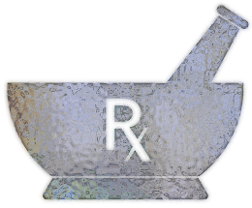
Our Culture of Addiction (continued)
Wide exposure to drugs with addictive potential
    Heavy prescription drug use
      4.3% world population and over 80% of prescribed opiates
    Illicit use of prescription drugs
    Increasing heroin purity
    Rise of synthetic drugs
(Pennsylvania Recovery Organizations Alliance, 2015)

Slide 9
Section iiI: impacts of addiction on child development

Slide 10
Adverse Childhood Experiences (ACE) Study
Assessed associations between childhood maltreatment (trauma) and later-life health and well-being.
Illicit drug use is identified in Healthy People 2010 as a leading health indicator because it is associated with multiple deleterious health outcomes.
Strong relationship to the risk of drug initiation from early adolescence into adulthood and to problems with drug use, drug addiction, and parenteral use.
(Pennsylvania Recovery Organizations Alliance, 2015)

Slide 11
Adverse Childhood Experiences
Abuse: Emotional, physical, and sexual
Neglect: Emotional and physical
Household Dysfunction
(NACA, 2011)

Slide 12
ACE Study Pyramid
Death
Early
Death
Disease, Disability
and Social Problems
Scientific gaps
Adoption of
Health-risk Behaviors
Social, Emotional, &
Cognitive Impairment
Adverse Childhood Experiences
Conception
(NACA, 2011)

Slide 13
Major Findings
ACE’s are common
  Two-thirds of participants reported at least one
  More than 20% reported three or more
Short-term and long-term outcomes of these childhood exposures include a multitude of health and social problems.
The ACE score used to assess the total amount of childhood stress.
As the number of ACE increase, the risk of health problems increases in a strong and graded fashion.
(NACA, 2011)

Slide 14
ACES and Children in Foster Care
Eighty percent of the children in foster care have at least one long-term health problem.
Twenty-five percent of the children in foster care have three or more long-term health problems
  This is 3-7 times greater than found among children living in poverty
(Dicker, S & Gordon, E. Page, 2002)

Slide 15
Section IV: drug use, addiction, and recovery

Slide 16
Drug Classifications
Tobacco
Alcohol
Cannabinoids
Opioids
Stimulants
Club Drugs
Dissociative Drugs
Hallucinogens
Prescription Drugs
Over-the-counter
Other Compounds
(Pennsylvania Recovery Organizations Alliance, 2015)

Slide 17
Methods of Drug Use
Smoking
Snorting
Injecting
Swallowing
Inhaling
Skin Absorption

Slide 18
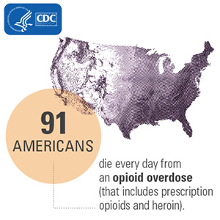
(CDC, 2016)

Slide 19
Opioid Basics, Opioid Drugs
Prescription Opioids
Prescription opioids can be prescribed by doctors to treat moderate to severe pain but can also have serious risks and side effects.
Common types are oxycodone (OxyContin), hydrocodone (Vicodin), morphine, and methadone.

Slide 20
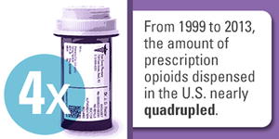
(CDC, 2016)

Slide 21
Opioid Basics, Opioid Drugs (continued)
Fentanyl
Fentanyl is a synthetic opioid pain reliever. It is many times more powerful than other opioids and is approved for treating severe pain, typically advanced cancer pain. Illegally made and distributed fentanyl has been on the rise in several states.

Slide 22
Opioid Basics, Opioid Drugs (cont.)
Heroin
Heroin is a powerful opiate drug. It looks like a white or brownish powder, or as the black sticky substance known on the streets as “black tar heroin.”
Some of the physical symptoms of heroin are euphoria, drowsiness, respiratory depression, constricted pupils, nausea, and dry mouth.
A heroin overdose causes slow and shallow breathing, blue lips and fingernails, clammy skin, convulsions, coma, and can be fatal.
Almost five million people have used heroin at some point in their lives.

Slide 23
Opioid Basics, Opioid Drugs (cont.)
Heroin
Heroin is an illegal opioid. Heroin use has increased across the U.S among men and women, most age groups, and all income levels.
The number of drug overdose deaths has never been higher and the majority of these deaths (more than six out of ten in 2015) involved opioids.

Slide 24
Prescription Opioids
Since 1999, the amount of prescription opioids sold in the U.S. nearly quadrupled. Deaths from prescription opioids drugs such as
  Oxycodone
  Hydrocodone
  Methadone

Slide 25
Prescription Opioids
Over 4 million Americans engaged in nonmedical use of prescription painkillers in the last month.
Approximately 1.9 million Americans met criteria for prescription painkillers use disorder based on their use of prescription painkillers in the last year.
Over 1 million people used prescription painkillers nonmedically for the first time in the past year.
The average age for prescription painkiller first-time use was 21.2 in the past year.

Slide 26
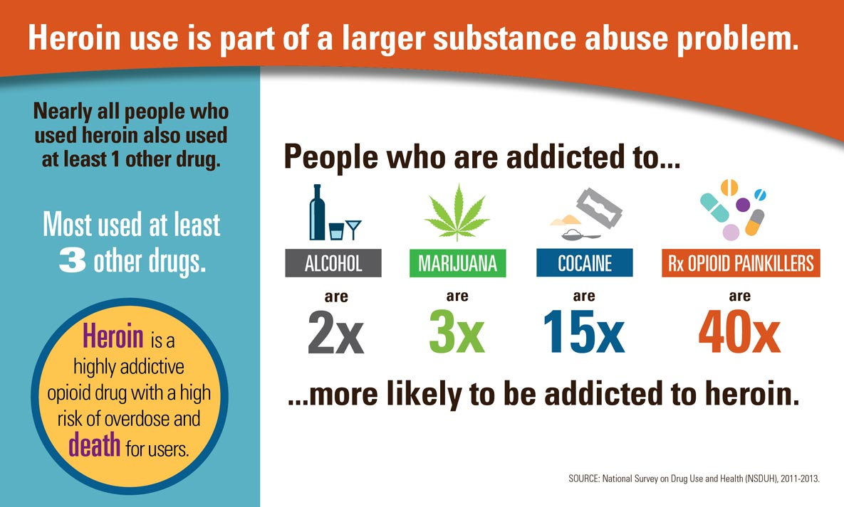
(CDC, 2016)

Slide 27
Stages of Addiction
Stage 1: Drug Experimentation
Stage 2: Social Drug Use and/or Regular Use
Stage 3: Problem Use and/or Risky Use (Binge Drinking)
Stage 4: Chemical Dependency (Psychological vs. Physical)
Stage 5: Addiction

Slide 28

Drug Effects
Dose – A specified quantity of a therapeutic agent, such as a drug or medicine prescribed to be taken at one time or at stated intervals.
Potency – strength, amount needed to produce an effect, usually in terms of milligrams.
Efficacy – Potential maximum therapeutic response.
Absorption – The movement of a drug into the bloodstream.
Toxicity – Critical or lethal reaction, human error or intentional overdose.
(Pennsylvania Recovery Organizations Alliance, 2015)

Slide 29


Consequences of Addiction
Physical
Spiritual Mental
Emotional
(Pennsylvania Recovery Organizations Alliance, 2015)

Slide 30
Seven Possible Signs of Drug Involvement
Change in school or work performance
Alteration of personal appearance
Mood swings or attitude changes
Withdrawal from responsibilities and/or family contacts
Association with drug using peers
Unusual patterns of behavior
Defensive attitude concerning drugs

Slide 31
Characteristics of Families Affected by Substance Use
Leads to:
An anxious family environment
Inconsistent parenting
Unpredictable rules
Rigid external boundaries
Inadequate personal boundaries
Secrets and shame-based life
Role reversal
Victim blaming
Lack of:
Self-actualization
Esteem
Love, affection, belonging
Safety
Physiological
=

Slide 32
Addressing Addiction
Voluntary- self-motivated
Involuntary- criminal justice system, children & youth services, employee assistance programs
Intervention- externally motivated
(Pennsylvania Recovery Organizations Alliance, 2015)

Slide 33
Section V: Supporting Recovery

Slide 34
Definition of Denial
Terence Gorski, N.C.A.C. II, C.S.A.C., a well-known professional in the field of addiction, defines denial as:
“… a normal response/defense for coping with painful and overwhelming problems. [Denial] has both benefits and disadvantages. The benefit is that it temporarily removes the pain caused by consciously confronting a serious problem while creating the illusion that the problem is being solved. The biggest disadvantage of denial is that it blocks recognition and problem solving.” (paragraph 2)

Slide 35
Identifying Denial Patterns
Comparing
Compliance
Avoidance
Absolute Denial
Minimizing
Rationalizing
Blaming
Manipulating
Flight into Health
Recovery by Fear
Strategic Hopelessness
The Democratic Disease State

Slide 36
Principles of Effective Drug and Alcohol Treatment
Behavioral therapies including individual, family, or group counseling are the most commonly used forms of drug abuse treatment.
Medications are an important element of treatment for many patients, especially when combined with counseling and other behavioral therapies.
An individual’s treatment and services plan must be assessed continually and modified as necessary to ensure that it meets his or her changing needs.
Many drug-addicted individuals also have other mental disorders.

Slide 37
Principles of Effective Drug and Alcohol Treatment (cont.)
Medically assisted detoxification is only the first stage of addiction treatment and by itself does little to change long-term drug abuse.
Treatment does not need to be voluntary to be effective.
Drug use during treatment must be monitored continuously as lapses during treatment do occur.
Treatment programs should test patients for the presence of HIV/AIDS, hepatitis B and C, tuberculosis, and other infectious diseases as well as provide targeted risk-reduction counseling, linking patients to treatment if necessary.

Slide 38
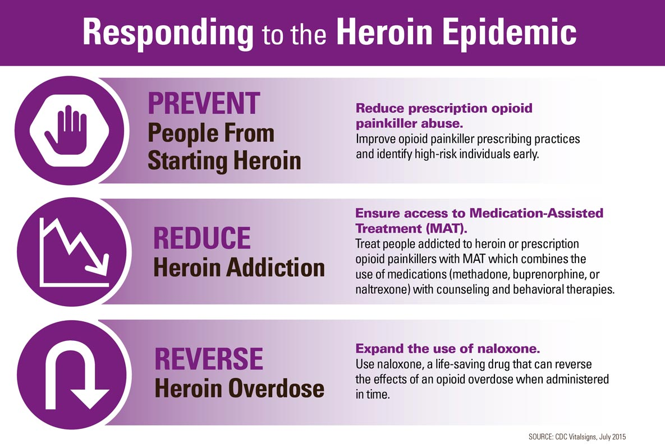
(CDC, 2015)

Slide 39
Making A Formal Referral
Two Types of Referrals
An informal referral, which usually occurs when substance uses does not endanger the safety or well-being of the child.
A formal referral, occurs when someone initiates a contract with an assessment, counseling, treatment, or other alcohol and other drug (AOD) agency on behalf of a client who has a substance abuse concern becomes vital.

Slide 40

Stages of Change Model
Carlo C. DiClemente and J. O. Prochaska developed model of change to help people understand addiction problems and motivation to change.
The six stages of the model are:
  Precontemplation
  Contemplation
  Determination
  Action
  Maintenance
  Reoccurrence
(Pennsylvania Recovery Organizations Alliance, 2015)

Slide 41

Four Dimensions of the Recovery Process
Health – Improving and sustaining health
Home—a stable and safe place to live
Purpose—conducting meaningful life activities
Community—having relationships and social networks that provide support, friendship, love, and hope
(Pennsylvania Recovery Organizations Alliance, 2015)

Slide 42
Community-Based Recovery Supports
Recovery House – unlicensed and unregulated facility in which recovering people rent living space and offer each other a supportive drug-free environment.
12-STEP Meetings - A support group setting of individuals supporting and encouraging one another through the recovery process.
Other Self-Help Recovery Support Groups (non 12-Step)
  Some are faith based
  Some are secular
(Pennsylvania Recovery Organizations Alliance, 2015)

Slide 43
Components of Recovery
Physical Recovery
good nutrition
exercise
adequate sleep,
Relaxation and medical help
Emotional Recovery
learning to cope with and calm feelings
reduce stress
change negative thinking
Spiritual Recovery
develop a sense of purpose and meaning in life
increase feelings of hope and joy
trust that there is good in life
Social Recovery
develop relationships with sober people
develop healthy social and leisure interests
learn or practice social skills
feel relaxed around and connected with sober people.
Family Recovery
examine effects of addiction on one’s family
involve
accept criticism
making amends

Slide 44
References
Gorski, T.T. (2001, Summer). Denial management counseling. Paradigm Magazine, 6(3) and 5(2), 20-21 Retrieved November 14, 2005 from https://terrygorski.com/2016/01/09/denial-management-counseling-dmc/
National Association of Children of Alcoholics. (2011). Celebrating Families. Retrieved from: http://www.celebratingfamilies.net/curriculum.htm
National Survey on Drug Use and Health. (2013). Heroin use is part of a larger substance abuse problem. Retrieved from: https://nsduhweb.rti.org/respweb/homepage.cfm##
Prochaska, J.O., & DiClemente, C.C. (1984). The transtheoretical approach: Crossing traditional boundaries of therapy. Homewood, III: Dow Jones-Irwin.
Substance Abuse and Mental Health Services Administration. (2016). Opioids. Retrieved from: https://www.samhsa.gov/atod/opioids

